Slide 1
Advantage and disadvantage of an organization utilizing E-Commerce
ABDUL RAHEEM RIHAM AHAMED
HND COMPUTING IDM

Slide 2
Table of contents
Advantage
Low financial cost
24×7 Potential Income
Sell Internationally
Affordable Employees
Can Scale Business Quickly
Disadvantage
No One Can Buy During a Site Crash
Shipping Times Can Be Lengthy
Customers Can't Try Before They Buy
References

Slide 3

Notes:
You have come to know the benefits of having an e-commerce business. Foremost among the list of benefits of e-commerce is a low financial cost, but other benefits include international sales, restructuring customers, and customizing the buying experience. These benefits of e-commerce will help you decide if starting an e-commerce store is right for you.

Slide 4

Low financial cost
Notes:
One of the advantages of e-commerce is that it has a low initial cost. Physics retailers can pay up to thousands of dollars to rent one of their stores. They include many obvious costs such as store labels, store layout, inventory purchase, sales team, and more. And let's not forget that the store owner must hire staff to work and operate each location. They may have to hire security guards depending on the value of the product in the store.
But E-Commerce Depending on the type of E-Commerce you are running, you may only need to hire employees as you reach a certain level. Since your online store is online, these employees can work remotely, making it easy to find the right employees for your company. If you choose Dropship online, you don't need to buy inventory in bulk to save a lot of money.

Slide 5


24$×$7 Potential Income
Notes:
Another advantage of e-commerce is that online stores are always open for business. With Facebook ads, you can impress someone at 11 pm. Or anywhere in the world at 4 p.m. In contrast, most location stores operate from 9 am to 9 pm, giving you a competitive edge. By being available at all times, you can attract people who pick up an item in stores if the store is open so you have a better chance of earning 24/7 revenue.

Slide 6

Sell Internationally
Notes:
Next on the list of benefits of e-commerce is the ability to easily sell a new brand to customers around the world. You can find out if your audience is in the UK, South America, or neighboring countries. If you opt for AliExpress Dropship, many products offer e-pocket shipping or free shipping at an affordable price. It allows you to set competitive prices for your products for a global audience.
Selling globally is a great achievement because it helps you build your brand faster, expands your market faster, and allows your local competitors to see profits in no time. In addition, with our international shipping tips, you can avoid many of the headaches associated with shipping products across borders.

Slide 7

Affordable Employees
Notes:
One of the benefits of e-commerce Employing staff Affordable. You can choose Outsourced work to virtual Assistants in countries. The cost of living is very low. You will be Fewer staff are needed E-commerce business rather than retail Location. A big advantage You do not need an e-commerce Hire staff at the start. you can Start and run an e-commerce Everything is yours.

Slide 8

Can Scale Business Quickly
Notes:
One of the advantages of e-commerce is that it is easy to scale the business. People can increase their advertising budget by clicking and buying without worrying too much about keeping demand, especially if you are directly shipping.
P Stores In fire stores, it is difficult to increase product taxes or add more ATMs due to limited space. You need to find a great place to scale your business, renew it or wait until your lease expires. If you create information products, you will again be a challenge as it takes time to write e-books, courses, and more.
With the Drop Shipping e-commerce model, you can add new products to your store without worrying about shipping products or maintaining inventory, allowing you to grow faster.

Slide 9

Notes:
Like every pro, there is a con. So, when starting an online store, it is important to be realistic. Below are some of the e-commerce drawbacks that merchants generally experience, which are not applicable to a p store fire shop.

Slide 10
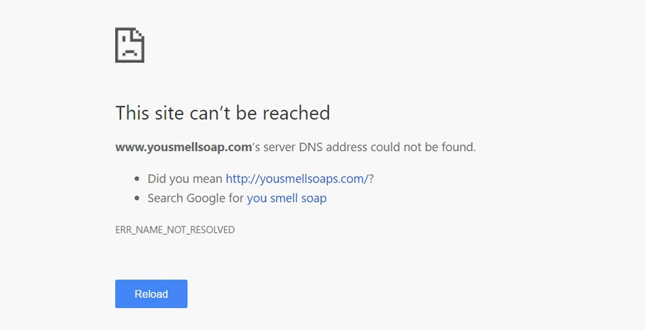
No One Can Buy During a Site Crash
Notes:
The worst of e-commerce vulnerabilities is when no one can buy from your store if your site crashes. That’s why it’s important to make sure your website is hosted on the right platform. For example, if you pay a minimal hosting fee and increase traffic from a high-conversion ad or a TV scream like a shark tank, your site will crash.
Fortunately, e-commerce solutions like Shopify offer free hosting for their monthly fee, which allows you to have one of the best servers on the market. In recent memory, there was only one time the sites were down. However, e-commerce stores are not the only affected sites. Twitter, Spotify, SoundCloud, and many more have been affected by this crash. The issue was resolved on the same day. However, site crashes on sites like Shopify are very rare and will not cause problems in your business.

Slide 11
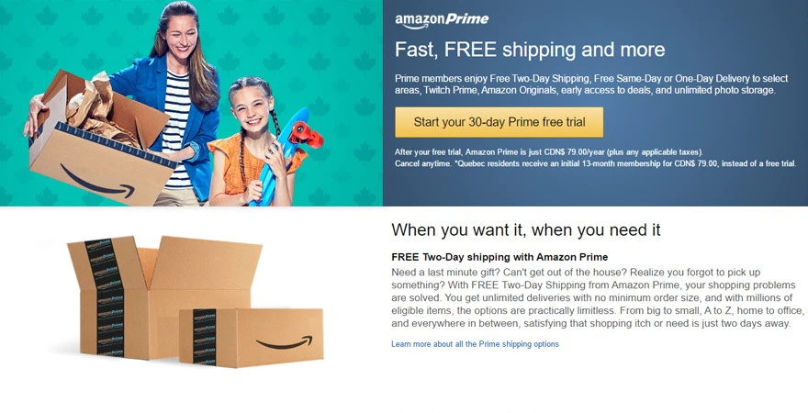
Shipping Times Can Be Lengthy
Notes:
Customers consider shipping times to be one of the worst e-commerce disadvantages. When a customer comes to the store in person, she can take the product home right away. But, with online shopping, most customers receive their products within a week or more.
Although Amazon offers one-day shipping, it is not a profitable model until they create Amazon Prime. It is profitable because they have tens of thousands of prime members. The solution is to be transparent with your customer. Let them know when to expect packages when they place an order.

Slide 12
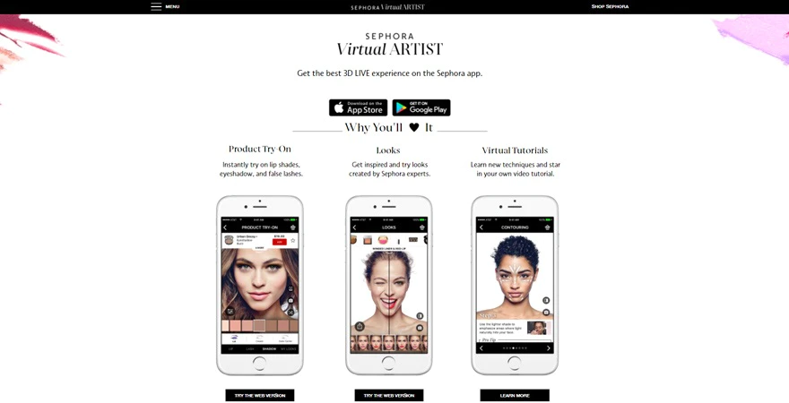
Customers Can't Try Before They Buy
Notes:
While this is currently an issue for many retailers, it will not be a long-term issue. With the growing reality, more and more stores are starting to add AR components to their store to allow customers to try products. Developed reality eCommerce companies offer solutions for businesses to create a more interactive experience with their customers.
How exactly does AR work? For example, you can see Sebora's Virtual Artist app. Beauty retailer offers customers an enhanced reality experience where they can try out different eye shadows, lip colors and more.

Slide 13
References
Oberlo (2021) 20 ECOMMERCE ADVANTAGES AND DISADVANTAGES YOU NEED TO KNOW, Available at: https://www.oberlo.com/blog/20-ecommerce-advantages-and-disadvantages (Accessed: 13th April 2021).

Slide 14
THANK YOU

